Slide 1
PROBLEM SOLVING AND PROGRAMMING USING PYTHON
Mr.Panduraju Pagidimalla
Assistant Professor, Dept of AIML

Slide 2
Techniques of Problem Solving

Slide 3
Decision Table

Slide 4
Decision table
A decision table is a table that indicates conditions and actions in a simplified and orderly manner.
Decision tables are used to model complicated logic.

Slide 5
A decision table can be described as cause-effect table and is the best way to deal with combination inputs with their associated outputs.
In a decision table, the logic is well divided into conditions, actions(decisions) and rules for representing the various components that form the logical model.

Slide 6
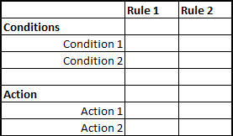
Standard format

Slide 7
Example: How to Create a Login Screen Decision Base Table
A login screen with E-mail and Password Input boxes.
Actions: The user will be routed to the homepage if they give the right username and password. An error warning will appear if any of the inputs are incorrect.

Slide 8
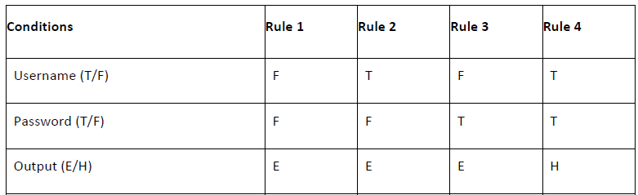
Example:
T - Make sure your login and password are correct.
F - Incorrect login or password
E - An error message appears.
H - The home screen appears.
Note: In a decision table, conditions are usually expressed as true (T) or false (F)

Slide 9
Interpretation
Case 1 − Both the username and password were incorrect. An error message is displayed to the user.
Case 2 − The username and password were both right, however, the password was incorrect. An error message is displayed to the user.
Case 3 − Although the username was incorrect, the password was accurate. An error message is displayed to the user.
Case 4 − The user's username and password were both accurate, and the user went to the homepage.

Slide 10
Exercise
A customer requests a cash withdrawal. One of the business rules for the ATM is that the ATM machine pays out the amount if the customer has sufficient funds in their account or if the customer has the credit granted. Draw decision table

Slide 11
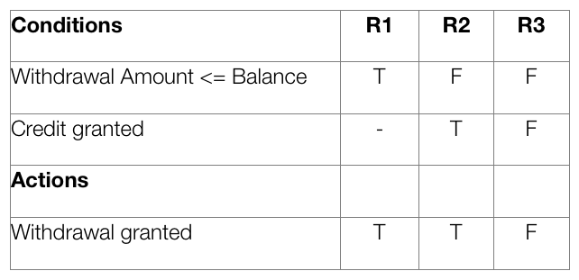

Slide 12
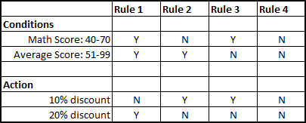
Example 3

Slide 13
Advantages Of Decision Table:
Decision rules are clearly structured.
Easy to use.
Easier to draw or modify in comparison to flowcharts.
They provide more compact documentation.
Documentation is easily prepared, changed or updated.
Decision tables can be changed easily according to the situation.
Decision tables summarize all the outcomes of a situation and suggest suitable actions.
Decision tables have a standard format.

Slide 14
Disadvantages Of Decision Tables:
Decision tables do not show the flow of logic for the solution to a given problem.
Decision table cannot list all alternatives.
Not easy to translate it.
Impose an additional burdens.
Decision tables only present a partial solution

Slide 15
THANK YOU !

